Slide 1
Machine Learning-Based Load Prediction for Network Function Virtualization Scenarios
Master‘s Thesis
by
Christoph Kaiser

Slide 2
Background - Network Function Virtualization
Separation from software and hardware
E.g. firewall
Functions can be placed on generic hardware in the network
Functions are combined to services
Algorithms must scale these services and place new function instances in the network
In todays large networks the placement and decisions can’t be made by a human

Slide 3
Background - Traffic Prediction
A problem with the NFV scaling algorithms is that they can only react to incoming traffic
If the traffic can be predicted the algorithms can make adjustments pro active
Start new Virtual Network Functions instances early
Shut down instances if they are not needed anymore
Keep instances running if new requests will be coming in shortly

Slide 4
Goals
Using historic data to train an deep learning network
Predicting service traffic at ingress nodes
Predict traffic for each service on its own
Is this a feasible approach for NFV

Slide 5
Neural Networks
Basic Neural Network
Multiple layer of neurons
Each neuron connects to all neurons of the next layer
The value (activation) of a neuron is the weighted sum of all previous neurons from the previous layer
Recurrent Neural Networks
Recurrent Neural Networks take a sequence as an input
Also take outputs from the previous steps as an input
RNN has the context for the previous value

Slide 6
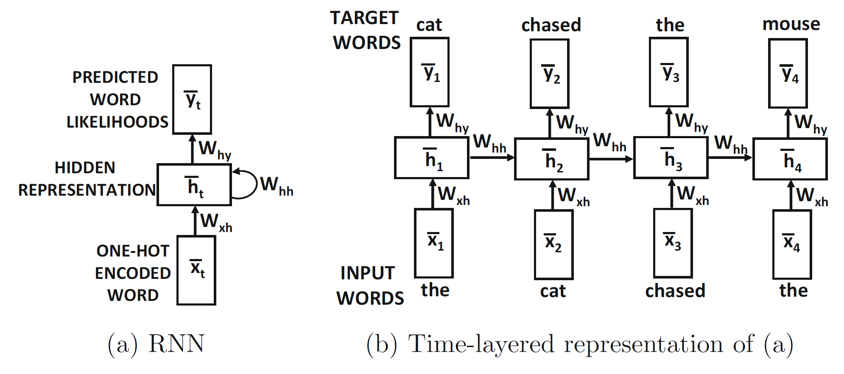
Recurrent Neural Networks

Slide 7
Long Short-Term Memory (LSTM)
LSTMs are a special RNN
In addition to previous step output a special cell state is transferred
This is not only information of the previous step but combines information of all previous steps.
The LSTM has context for all previous values

Slide 8
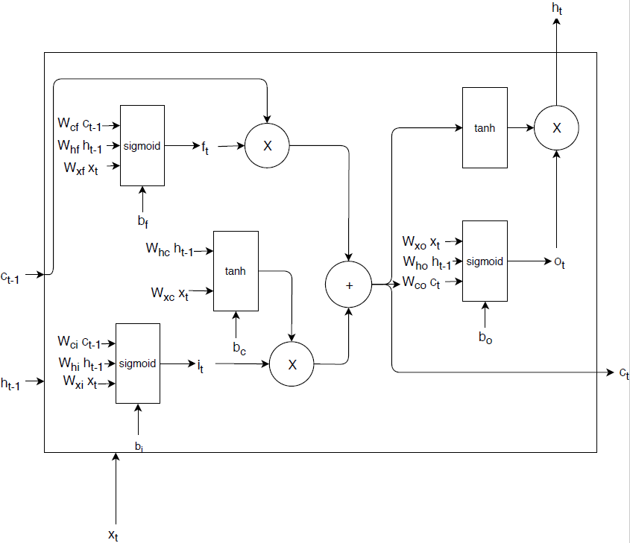
LSTM Architecture
The LSTM architecture include multiple gates:
Input gate
Forget gate
Output gate

Slide 9
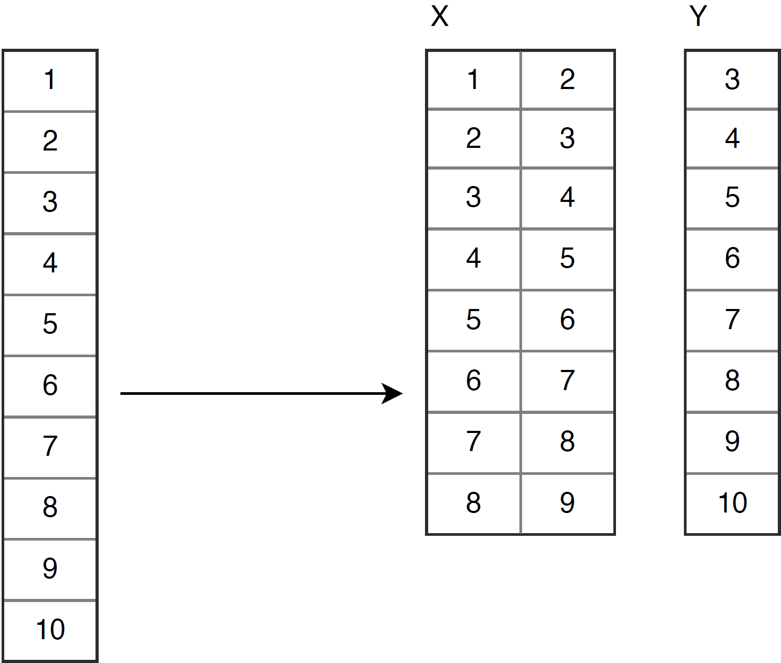
LSTM Training
Input sequence is split up into many small sequences
LSTM is trained with these small sequences and corresponding target values

Slide 10
Datasets
Found six different sets of network data:
Alibaba data center
Network simulation data
2.5 years of Google DNS traffic
University IP-Packets annotated with applications
GÉANT research network traffic
Abilene research network traffic

Slide 11
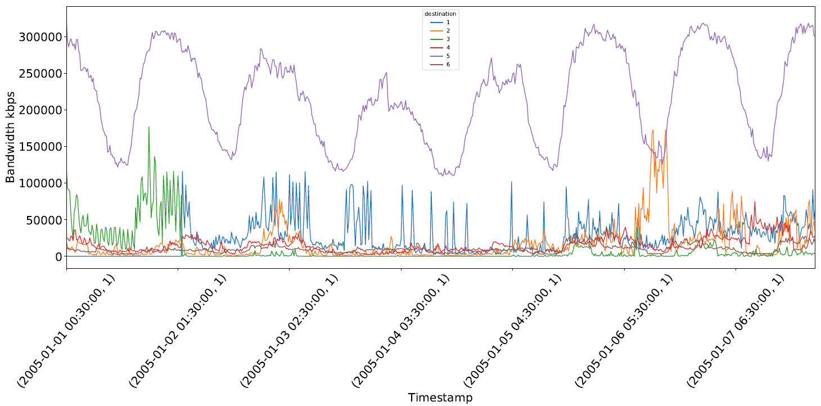
Datasets
GÉANT research network traffic

Slide 12
Test Data
Used sources: 1 – 5
Used destination: 11
Sources are interpreted as services
Destinations are interpreted as ingress nodes
Used the 1199 most current values for training and testing
999 values for training (20% for validation)
200 values for testing

Slide 13
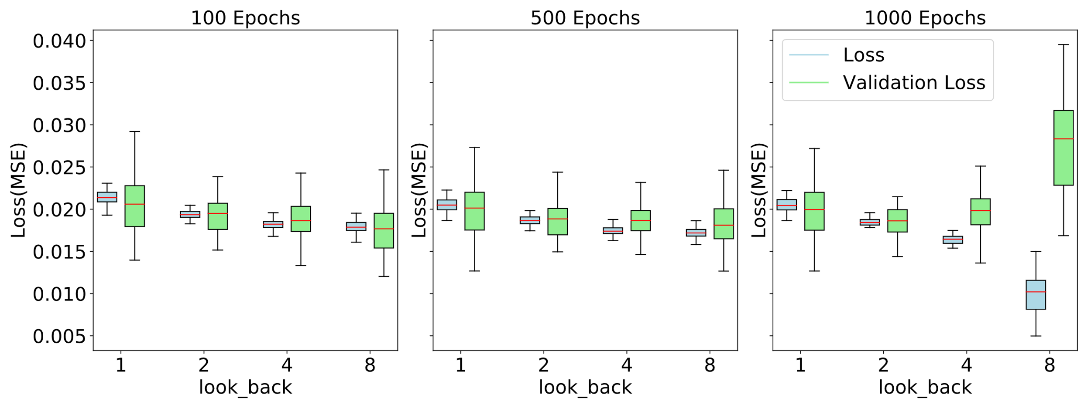
LSTM Hyperparameter-Tuning
Pair (1,11)
Notes:
Parameters
Hidden Nodes
Previous values (look_back)
Number of batches
LSTM layers
Parameter values
Batch_size = 100
Nodes = 128
Layers 1
Optimizer adam

Slide 14
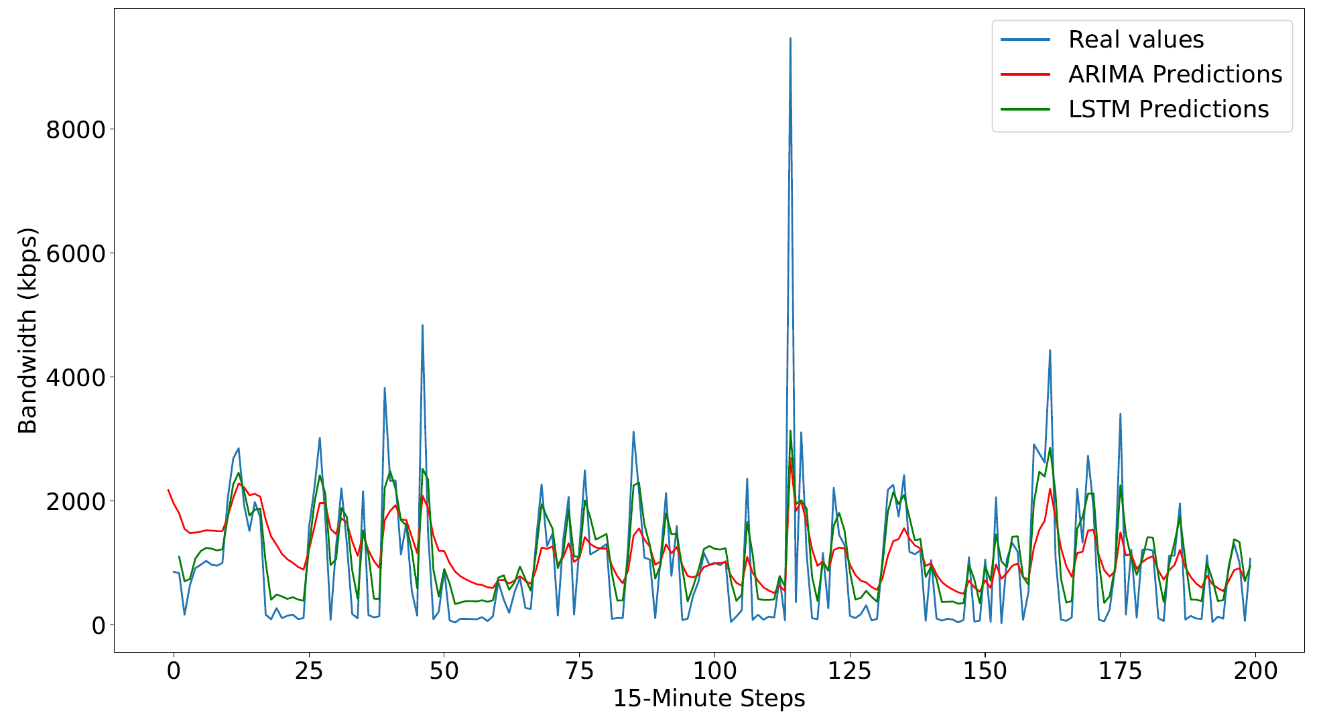
LSTM vs. ARIMA
Pair (1,11)
Notes:
1000 epochs
128 batches
1 node
1 layer
2 look_back

Slide 15
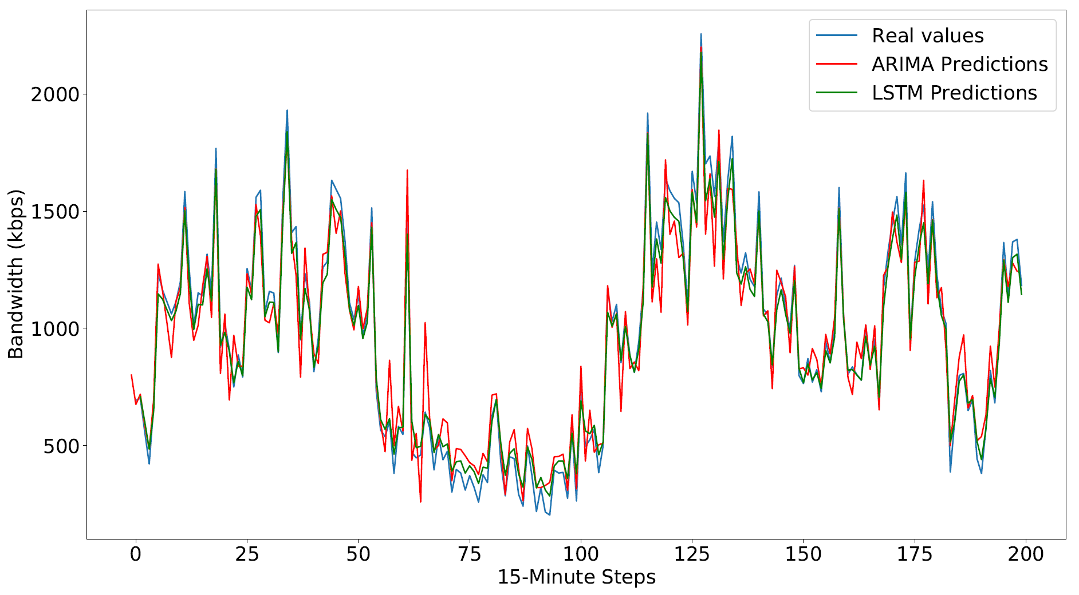
LSTM vs. ARIMA
Pair (4,11)

Slide 16
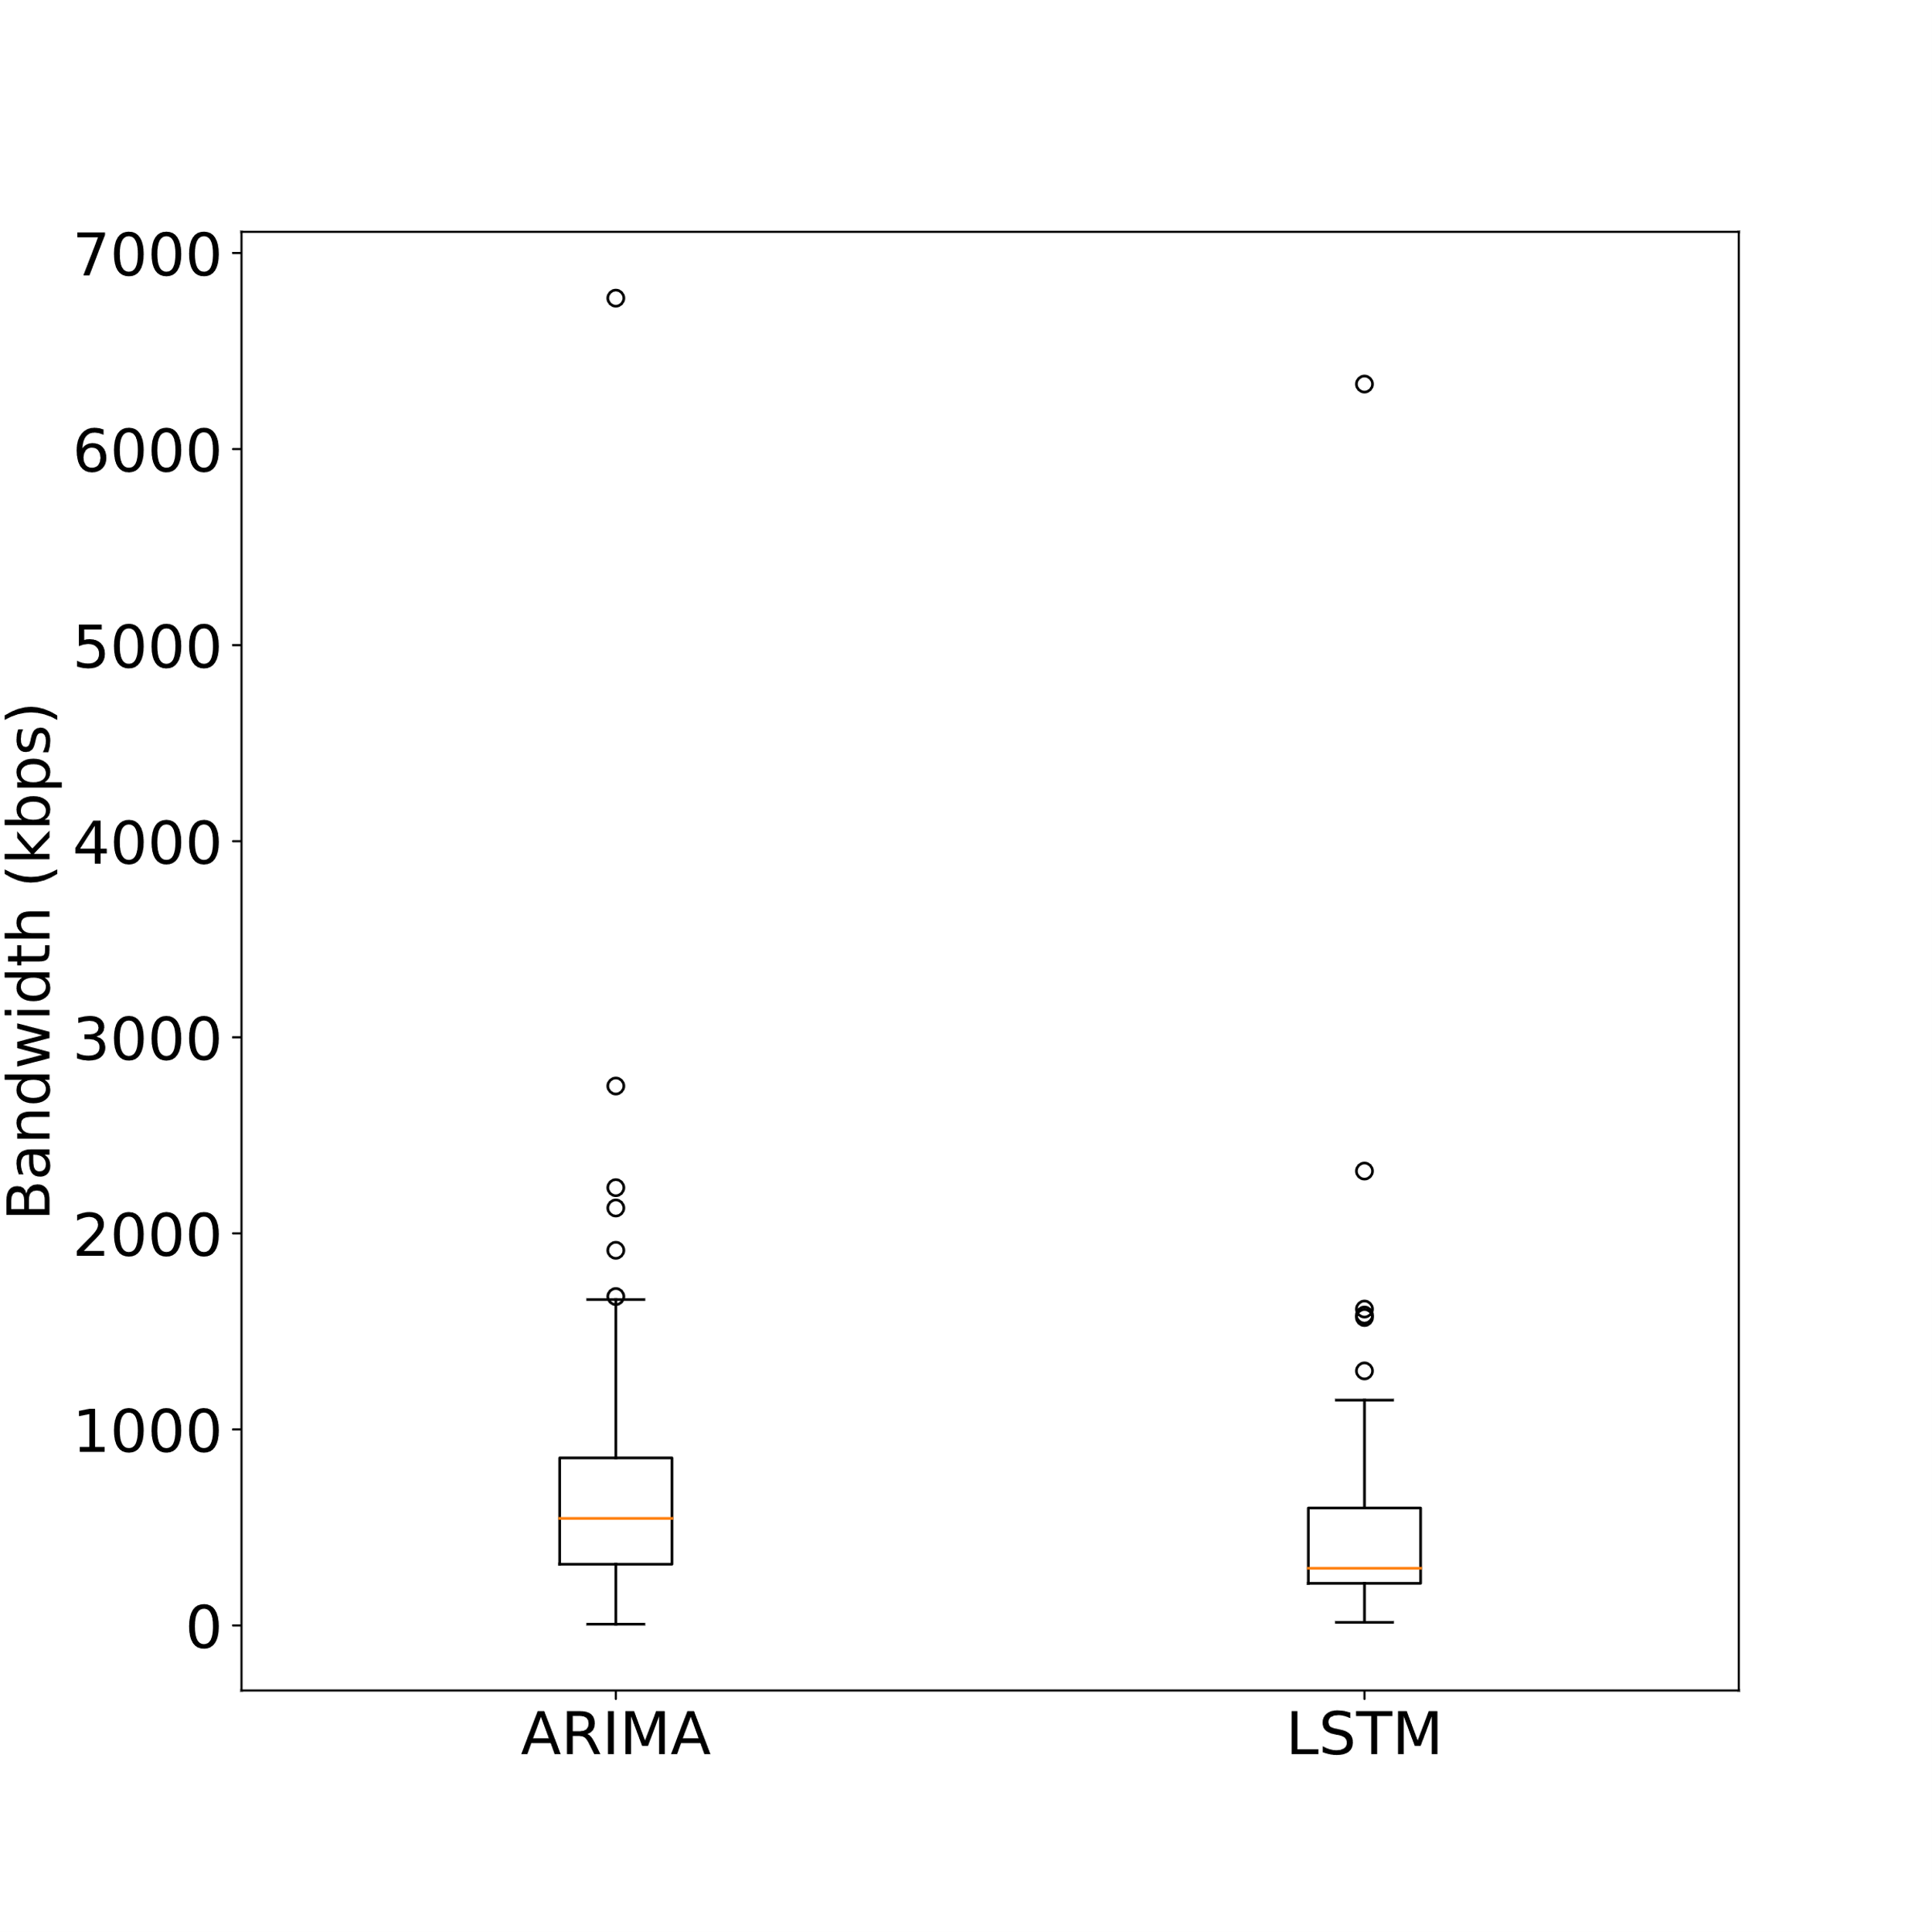
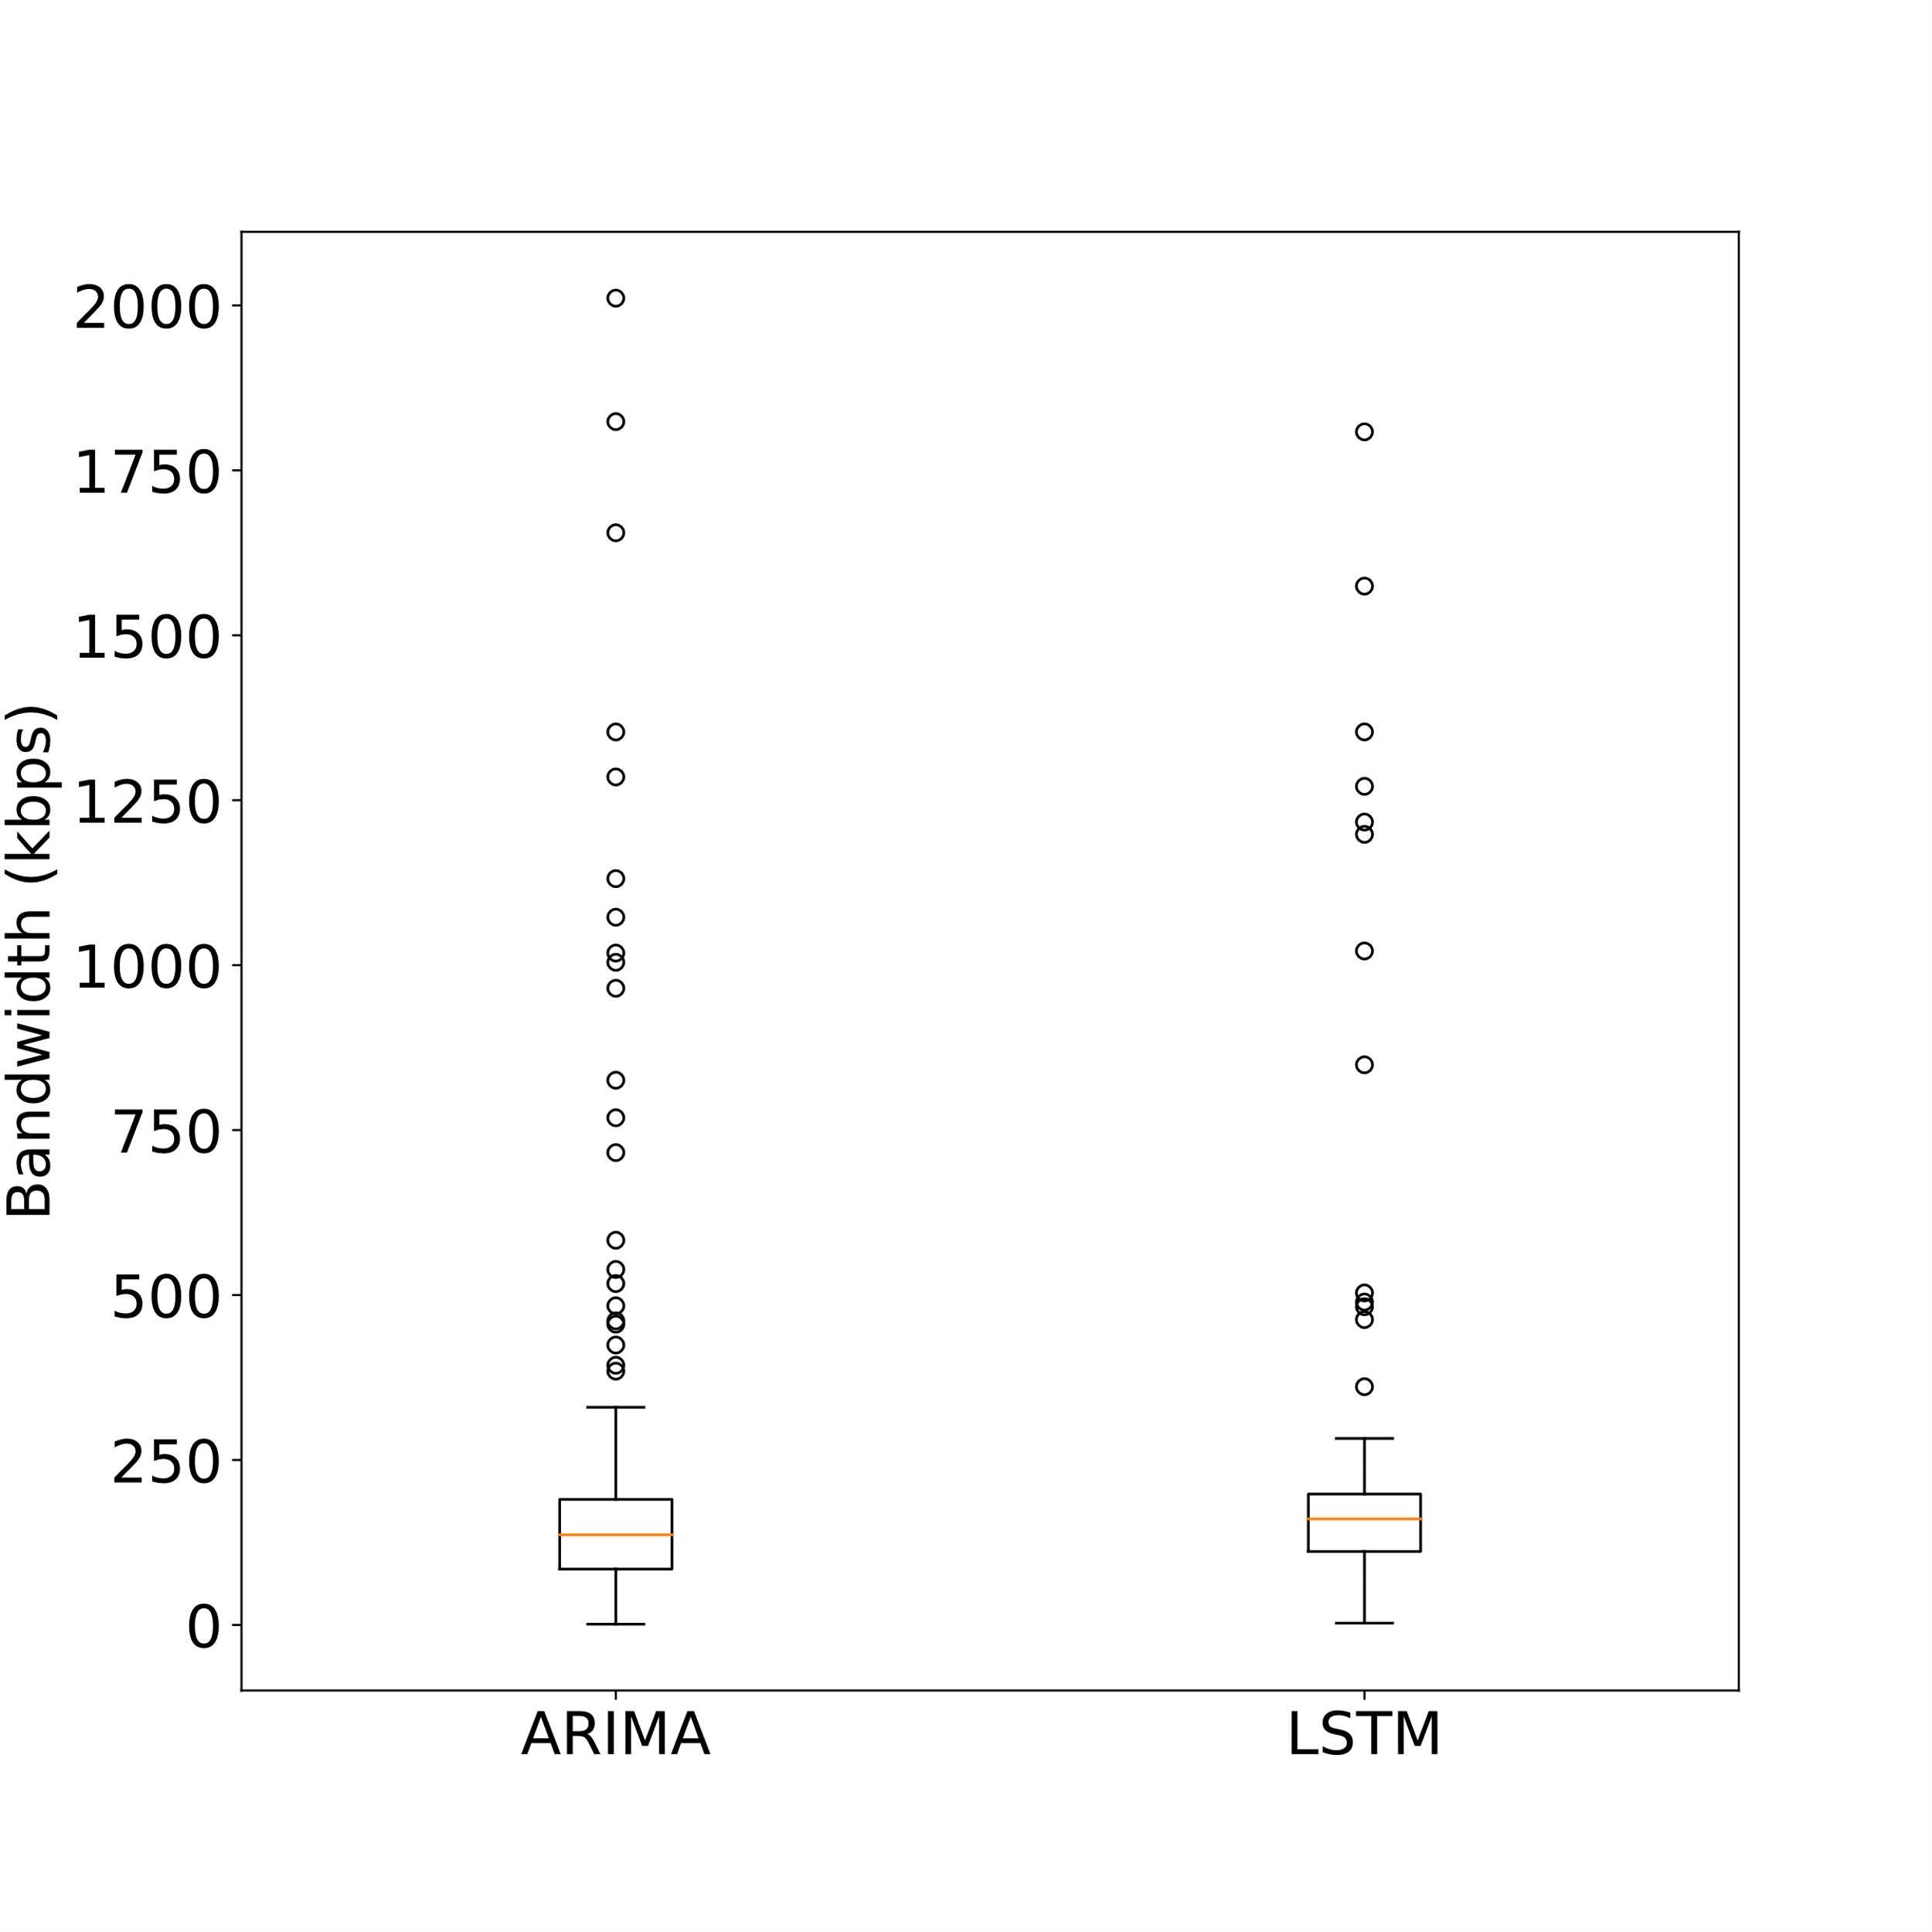
LSTM vs. ARIMA
Pair (1,11)
Pair (2,11)

Slide 17
Future Work & Conclusion
Future Work
Testing on a live system
Analyze reaction of VNF scaling algorithm to predicted traffic
Test other RNN layers
Keras supports Gated Recurrent Units and Convolutional LSTM 2-Dimensional
Switch to on-the-fly learning
Additionally test the Abilene set
5-Minute steps of the Abilene set may have more correlation between each other

Slide 18
Future Work & Conclusion
Conclusion
Both LSTM and ARIMA return usable results for predicting one step ahead
Machine learning can improve NFV scaling algorithms

Slide 19
References
C. C. Aggarwal, Neural Networks and Deep Learning. Springer International Publishing 2018
A. Graves, "Generating sequences with recurrent neural networks," CoRR, vol. abs/1308.0850, 2013.
S. Orlowski, M. Pioro, A. Tomaszewski, and R. Wessäly, „SNDlib 1.0-Survivable Network Design Library," in Proceedings of the 3rd Inter-national Network Optimization Conference (INOC 2007), Spa, Belgium, April 2007. http://sndlib.zib.de, extended version accepted in Networks,2009.
S. Orlowski, M. Pioro, A. Tomaszewski, and R. Wessäly, „SNDlib 1.0-Survivable Network Design Library,” Networks, vol. 55, no. 3, pp. 276-286, 2010.

Slide 20
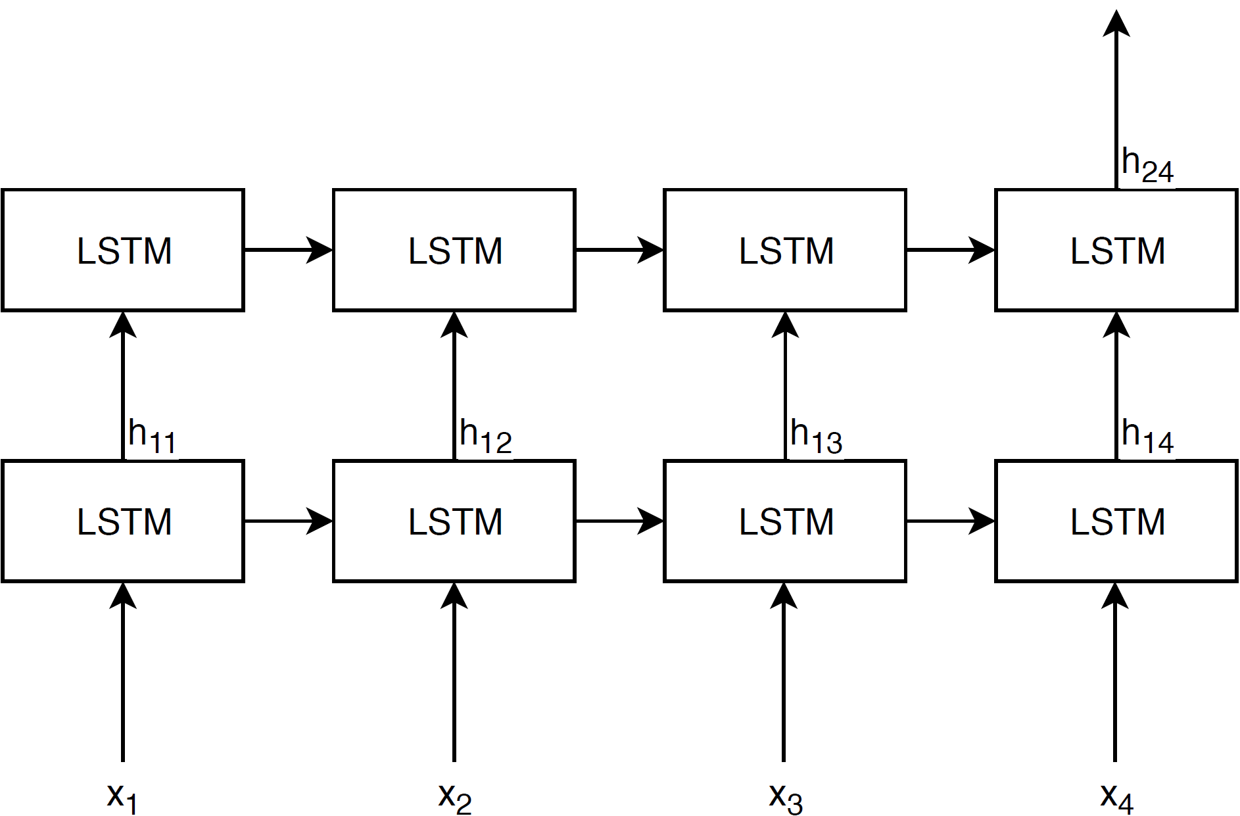

Slide 21
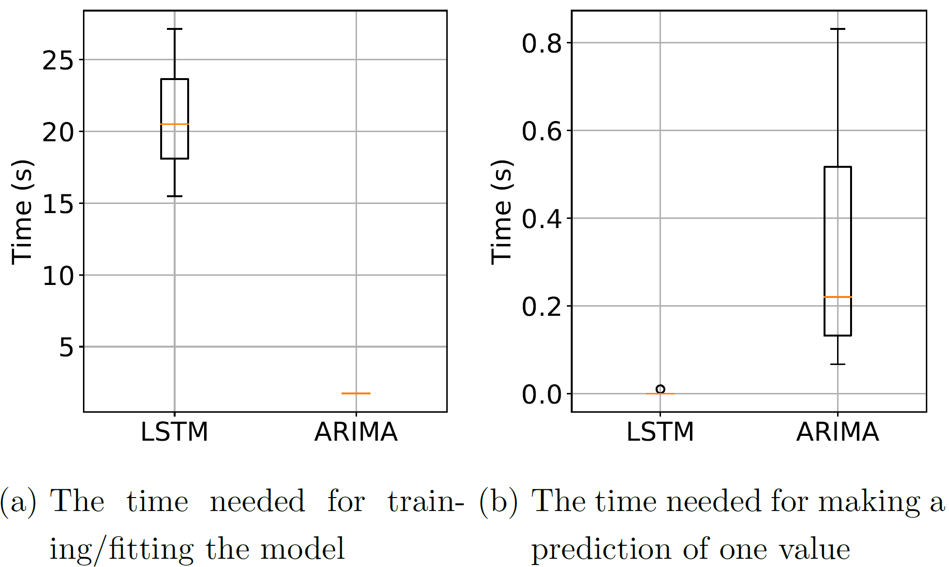

Slide 22
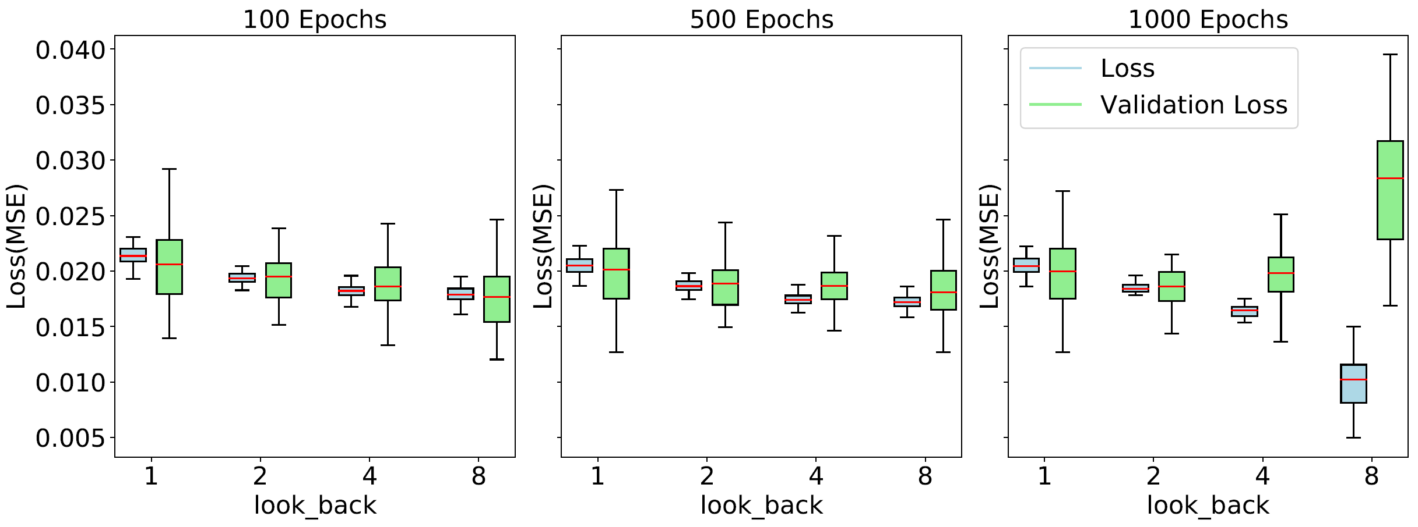
LSTM Hyperparameter-Tuning
Pair (1,11)
Notes:
Parameters
Hidden Nodes
Previous values (look_back)
Number of batches
LSTM layers
Parameter values
Batch_size = 100
Nodes = 128
Layers 1
Optimizer adam

Slide 23
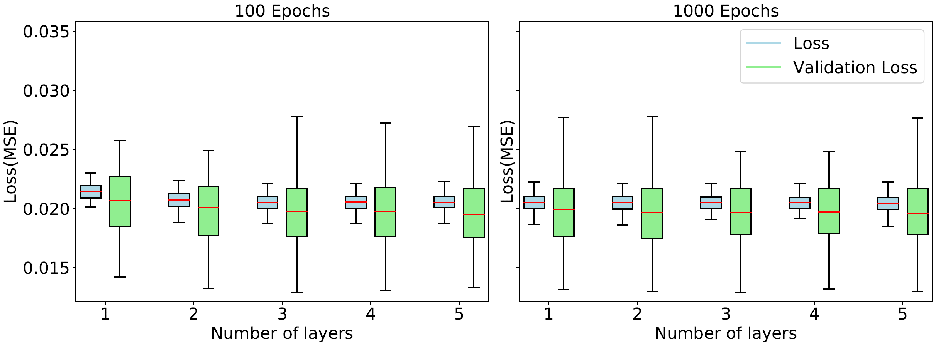
LSTM Hyperparameter-Tuning
Pair (1,11)
Notes:
Parameters
Hidden Nodes
Previous values (look_back)
Number of batches
LSTM layers
Parameter values
Batch_size = 100
Nodes = 128
Layers 1
Optimizer adam

Slide 24
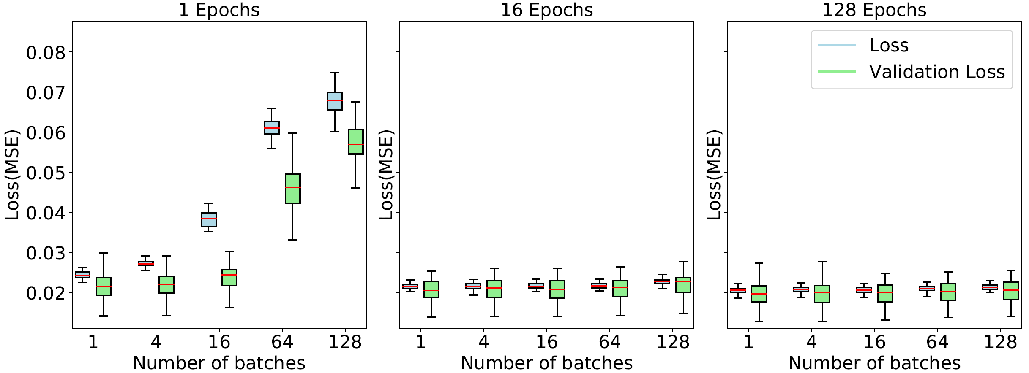
LSTM Hyperparameter-Tuning
Pair (1,11)
Notes:
Parameters
Hidden Nodes
Previous values (look_back)
Number of batches
LSTM layers
Parameter values
Batch_size = 100
Nodes = 128
Layers 1
Optimizer adam

Slide 25
